Slide 1

DEPARTMENT OF COMPUTER SCIENCE & ENGINEERING
SCHOOL OF COMPUTING
1156CS601- MINOR PROJECT
WINTER SEMESTER 22-23
SEMESTER END PROJECT VIVA VOCE EXAMINATIONS
“FRAUD CREDIT CARD DETECTION SYSTEM USING MACHINE LEARNING ”
SUPERVISED BY
MS.T.GANGALAKSHMI,M.E.
ASSISTANT PROFESSOR
PRESENTED BY
1. NALLURI KARTHIK (VTU 15337)(20UECS0659)
2. CHEELLA BALAJI (VTU 17056)(20UECS0193)
3. K. LOKESH (VTU 18313)(20UECS0452)

Slide 2
AGENDA
ABSTRACT
OBJECTIVE
INTRODUCTION
LITERATURE REVIEW (SOFT COPY OF PAPERS TO BE LINKED AS HYPERLINK)
DESIGN AND METHODOLOGIES
STANDARDS & POLICIES USED
IMPLEMENTATION
TESTING
INPUT AND OUTPUT
INCLUDE DEMO VIDEO (You Tube URL )
CONCLUSION
FUTURE ENHANCEMENTS
WEB REFERENCES LINK
REFERENCES
PLAGIARISM REPORT OF PPT
POSTER PRESENTATION

Slide 3
ABSTRACT
The credit card fraud detection system using logistic regression, one of the most widely used machine learning algorithms for binary classification problems.The classifier with better rating score can be chosen to be one of the best methods to predict frauds. Thus, followed by a feedback mechanism to solve the problem of concept. The system analyzes a variety of transaction features, such as transaction amount, location, and time, to identify anomalous patterns and behaviors that are indicative of fraud. The logistic regression algorithm is trained using a large dataset of known fraudulent and legitimate transactions to classify new transactions as either fraudulent or legitimate. The system’s performance is evaluated using various metrics such as accuracy, precision, recall, and F1-score. The experimental result that the proposed system achieves high accuracy and precision in detecting fraudulent transactions using logistic regression. This indicates that logistic regression is a promising solution for credit card fraud detection, and the proposed system can be a valuable tool for businesses and financial institutions to prevent financial losses due to fraudulent transactions.In this proposed system, we present a logistic regression-based approach to detect fraudulent credit card transactions, which can help financial institutions to prevent fraud and protect their customers accounts.

Slide 4
OBJECTIVES
Aim of the project:-
The aim of using logistic regression in fraud credit card detection using machine learning is to develop a system that can accurately and efficiently identify fraudulent credit card transactions. The logistic regression algorithm is used to classify new transactions as either legitimate or fraudulent based on the analysis of various transaction features. The goal is to develop a system that can detect fraudulent transactions with a high degree of accuracy and precision, while minimizing the number of false positives and false negatives.
Scope of the project:-
The project scope involves collecting and processing a large dataset of credit card transactions that can be used to train and test the logistic regression algorithm. This includes identifying and removing any missing or incorrect data and selecting relevant features that can be used to detect fraudulent transactions.

Slide 5
INTRODUCTION
Credit card fraud is a significant threat in the BFSI sector. This credit card fraud detection system studies and analyzes user behavior patterns and uses location scanning techniques to identify any unusual patterns.One of The user patterns includes important user behavior like spending habits, usage patterns, etc. All the information that also has a large volume, wide range, frequency,as well as importance is stored from small to large organizations over the cloud.
Machine learning is the innovation of this century that eliminates conventional
strategies and also can function on huge datasets where humans can’t immediately
access. Strategies of machine learning break within two important categories; supervised learning versus unsupervised learning; Tracking of fraud can also be achieved form and may only be determined how to use as per the datasets.s. Most payments are legitimate in several available evidence sets, with such an extremely small number of fraudulent ones. The significant challenges to investigators are designing the accurate as well as efficient fraud prevention framework that will be low on false positives but efficiently identifies fraud activity .

Slide 6
LITERATURE REVIEW
A. H. Alhazmi et.al.,[2022] [1] evaluated the performance of classifiers or predictors,such as the Vector Machine, Random Forest, and Decision Tree. These metrics areeither prevalence-dependent or prevalence-independent. Further more, these tech_x0002_niques are used in credit card fraud detection mechanisms, and the results of thesealgorithms have been compared.With these they have focused on the two ways of credit card transactions i) Virtually (card, not present) ii) With Card or physically present.
Armel et.al.,[2021] [2] proposed support vector machines(SVM), artificial neural net_x0002_works(ANN), Bayesian Networks, Hidden Markov Model, K-Nearest Neighbours (KNN) Fuzzy Logic system and Decision Trees. In their paper, they have observed that the algorithms k-nearest neighbor, decision trees, and the SVM give a medium level accuracy.
F. Ghobadi et.al.,[2021] [3] proposed some important algorithmic techniques which are the Whale Optimization Techniques (WOA) and SMOTE (Synthetic Minority Over sampling Techniques). They mainly aimed to improve the convergence speed and to solve the data imbalance problem. The class imbalance problem is overcome using the SMOTE technique and the WOA technique.

Slide 7
LITERATURE REVIEW
A. Mishra et.al.,[2020] [5] proposed a novel fraud detection method that has four stages they first utilize the historical transaction data to divide them into groups to form clusters of transactions having the same behavior they came up with a sliding windows Strategy to aggregate transactions.This algorithm is used to characterize the behavioral pattern of a cardholder then after aggregation, we use the new window formed the feature extraction is done.
Rimpal R. Popat et.al.,[2019] [6] proposed supervised machine learning algorithms on the real-world data set and then used those algorithms to implement a super classifier using ensemble learning and then they compared the performance of supervised algorithms with their implementation of a super classifier. They used ten machine learning algorithms such as Random Forest, Stacking Classifier, XGB Classifier, Gradient Boosting, Logistic Regression, MLP Classifier, SVM, Decision Tree, KNN, Naive Bayes.
Rishi Banerjee et.al.,[2018] [7] proposed ”Credit card fraud detection using logistic regression and artificial neural network” presents a credit card fraud detection system that utilizes logistic regression and artificial neural network (ANN) models.

Slide 8
DESIGN AND METHODOLOGIES
MODULE 1:Requirement Analysis,System Design
MODULE 2:Coding,Implementation,Testing,Maintenance

Slide 9
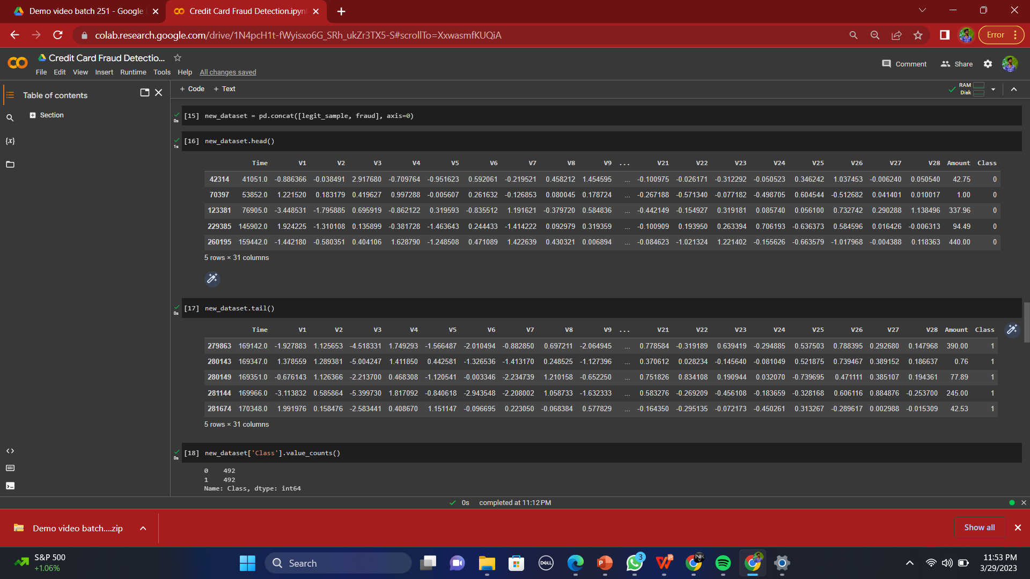
Module 1 -Requirement Analysis Step:1 Perform Exploratory Data Analysis (EDA)* There are a total of 284,807 transactions with only 492 of them being fraud. Let’s import the necessary modules, load our dataset, and perform EDA on our dataset.

Slide 10

Step 2: Processing of data Write a code to extract the required features from the URL database. Analyze and preprocess the dataset by using EDA techniques. Divide the dataset into training and testing sets.abase

Slide 11

Module-2:Testing and maintenance Step 3: Apply Machine Learning Algorithms to Credit Card Dataset
Run selected machine learning and logistic regression, Autoencoder on the dataset.
Write a code for displaying the evaluation result considering accuracy metrics.
Compare the obtained results for trained models and specify which is better.

Slide 12

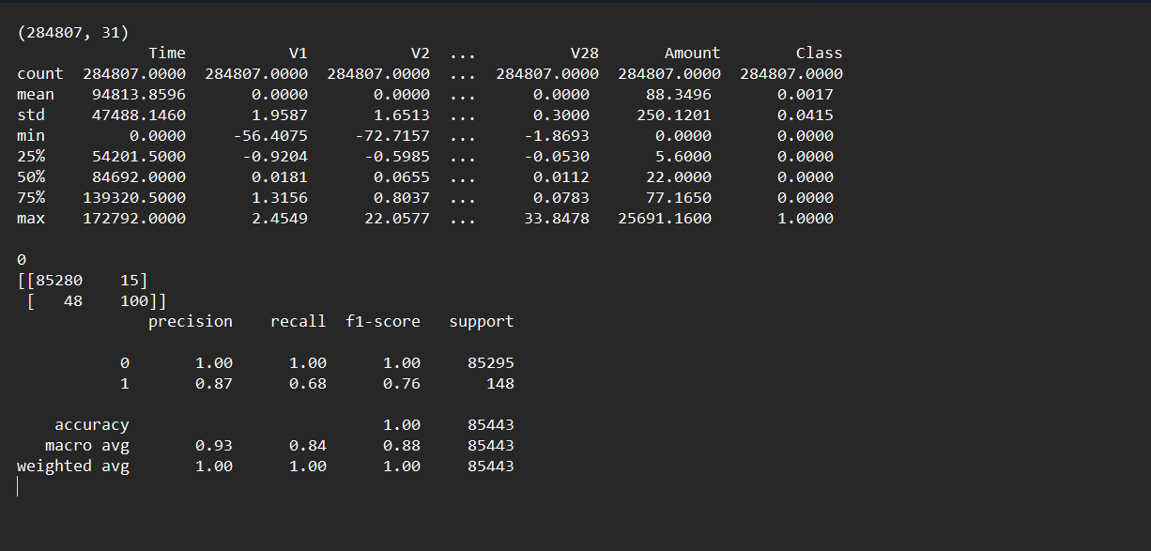
Step 4: Get the Output

Slide 13
Standards & Policies
Python Standard Used: ISO/IEC WD TR 24472-4:ISO/IEC WD TR 24772-4 Programming languages — Avoiding vulnerabilities in programming languages — Part 4: Vulnerability descriptions for the programming language Python General information
Status : Under development,
Edition : 1,
Technical Committee : ISO/IEC JTC
1/SC 22 Programming languages,
their environments and system software interfaces,
ICS : 35.060 Languages used in information technology
PyCharm Standard Used: ISO 2022.1 Build 221.5591.52

Slide 14
IMPLEMENTATION
Architecture Diagram
Data –Flow Diagram
Use Case Diagram
Class Diagram
Activity Diagram
Sequence Diagram

Slide 15
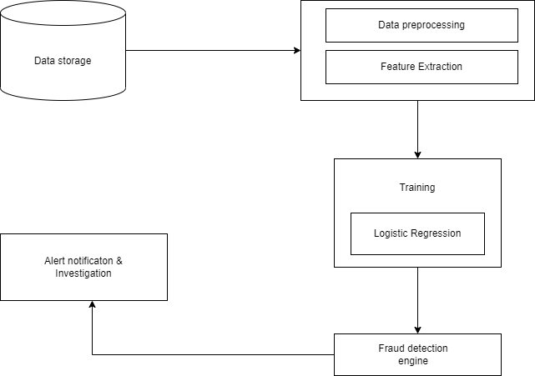
Architecture Diagram

Slide 16
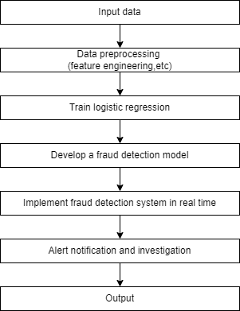
Data –Flow Diagram

Slide 17
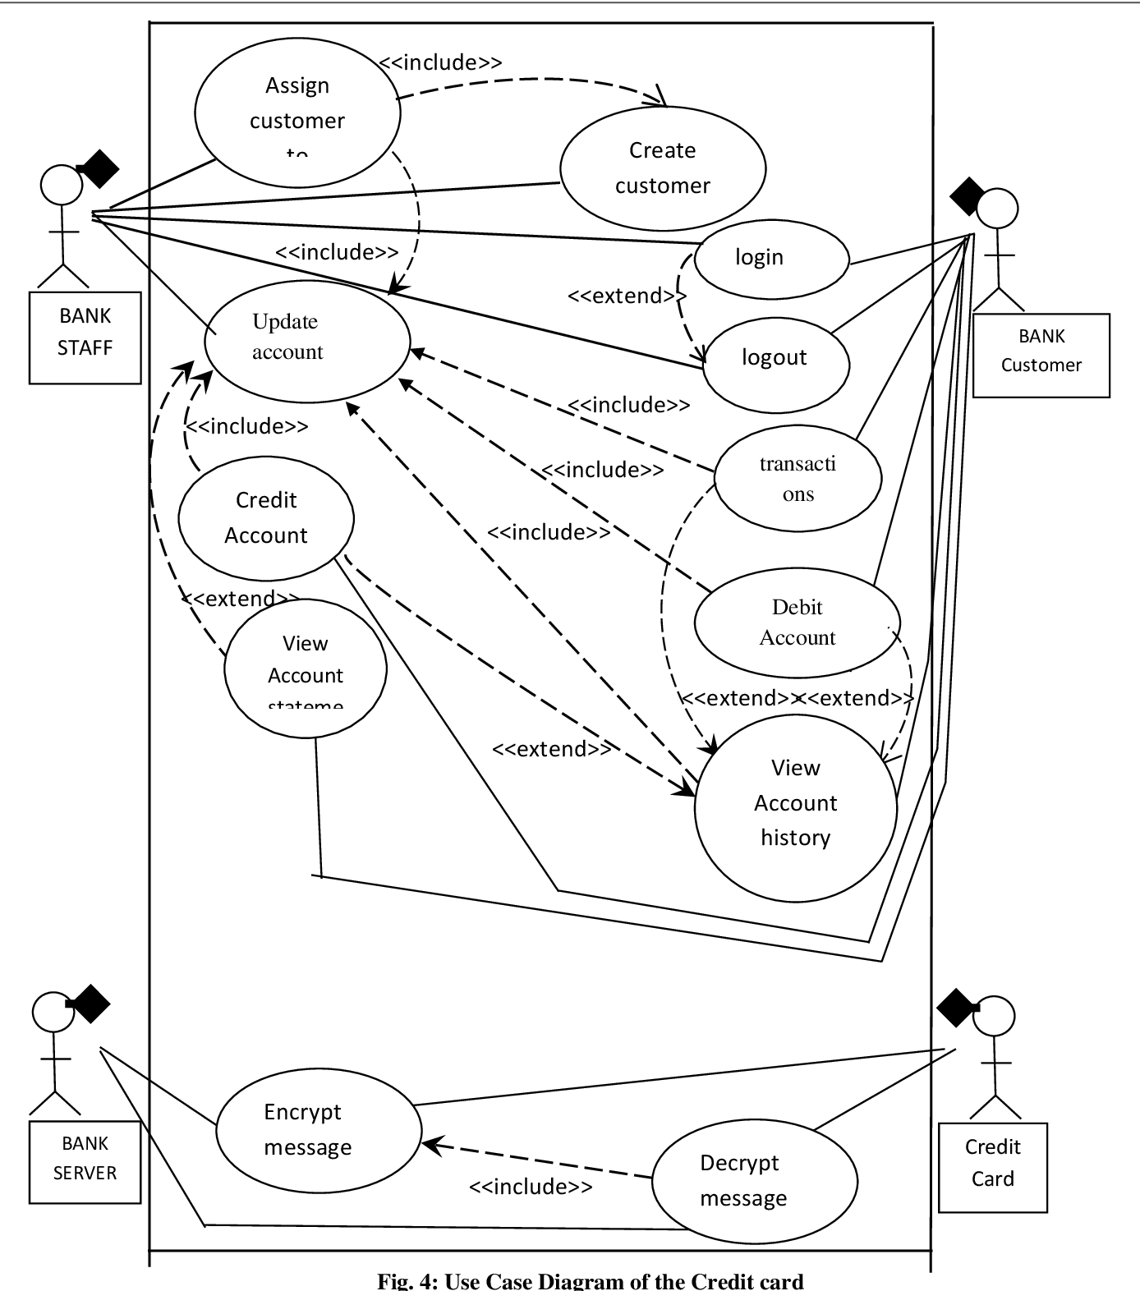
Use Case Diagram

Slide 18
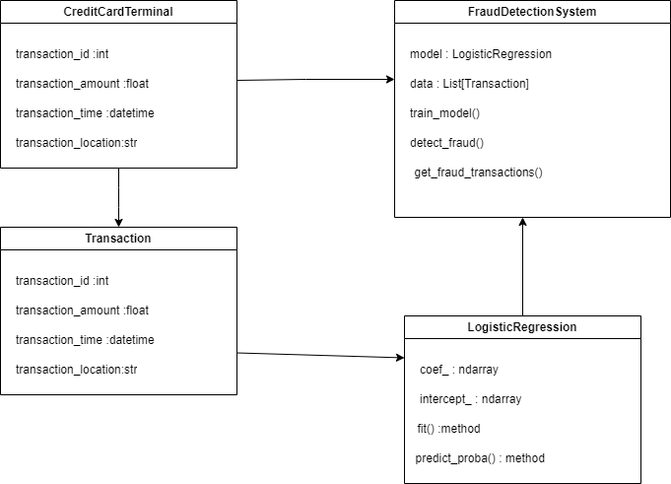
Class Diagram

Slide 19
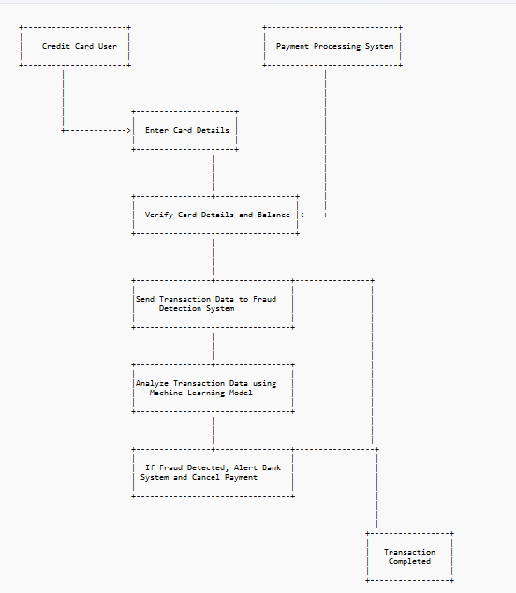
Activity Diagram

Slide 20
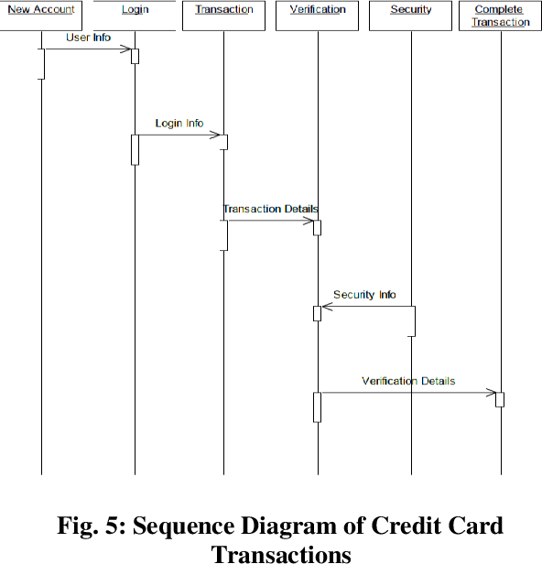
Sequence Diagram

Slide 21
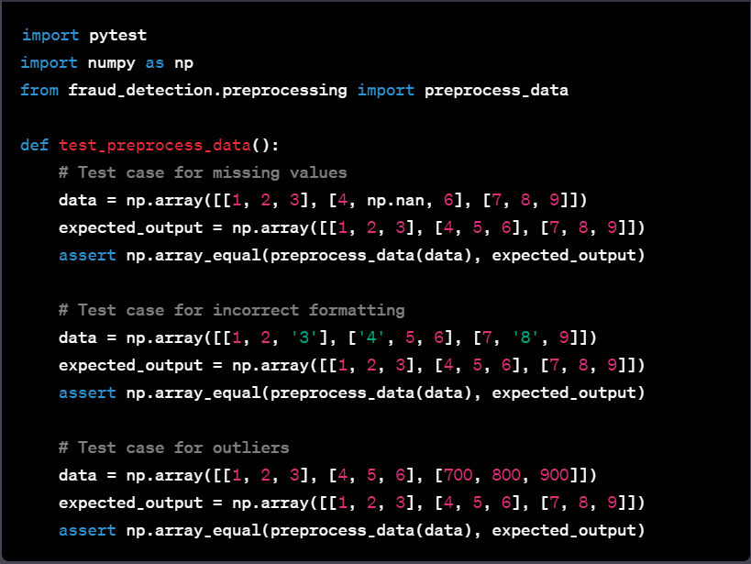
TESTING
UNIT TESTING:
The unit testing is an important aspect of developing a fraud credit card detection system using machine learning in logistic regression. It involves testing individual components or modules of the system to ensure that they are working as expected and producing the desired results. To conduct unit testing, developers may use frameworks such as PyTest or Unit Test in Python.

Slide 22
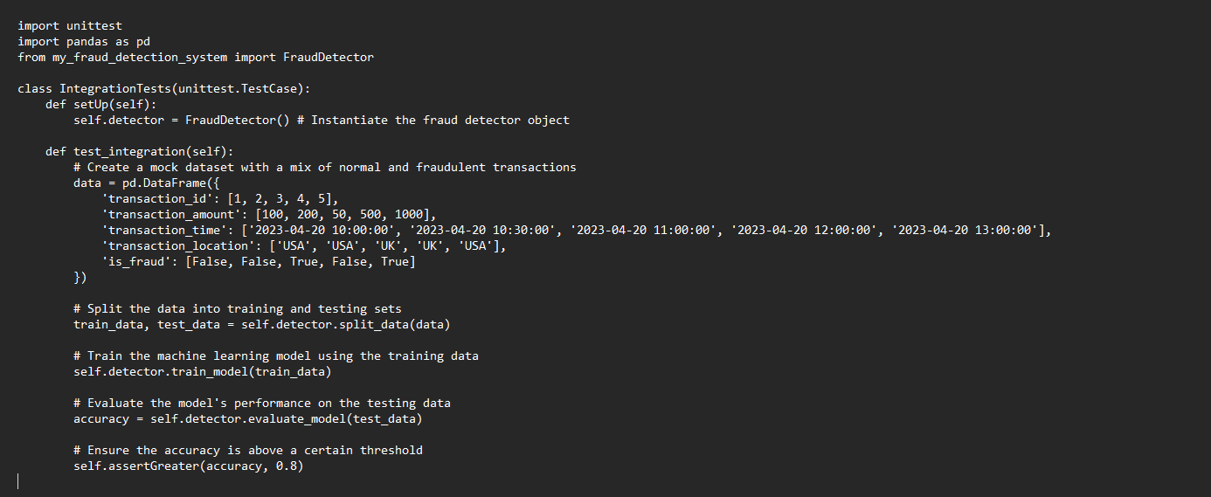
Integration testing:
The integration testing of a fraud credit card detection machinelearning code involves testing the interaction and integration between different modules of the code to ensure that they work together seamlessly. Define integration points: Determine the integration points between the modules. Integration points arethe points where two or more modules interact with each other.

Slide 23
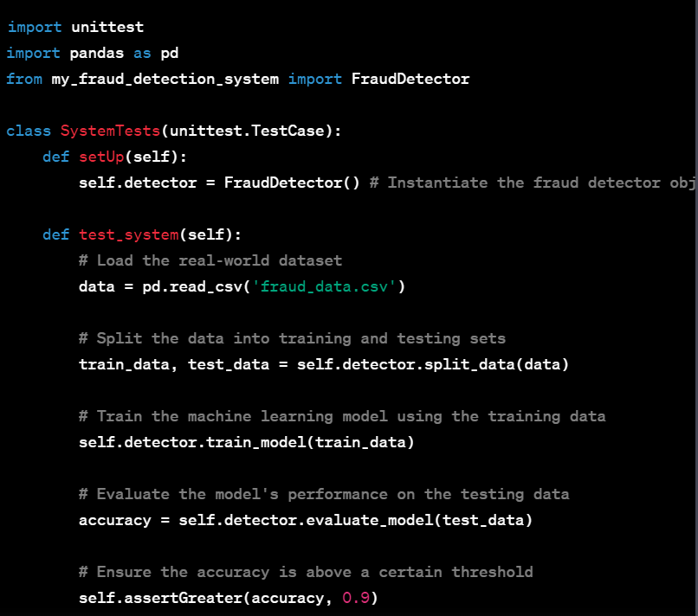
System testing:
The System testing of a fraud credit card detection machine learning code involves testing the entire system end-to-end to ensure that it meets the specified requirements and performs as expected. Monitor the system performance: Monitor the system performance during the tests to ensure that it meets the performance requirements, such as processing speed and accuracy. Record and report the results: Record the results of the system tests and report any issues or defects that are found.

Slide 24
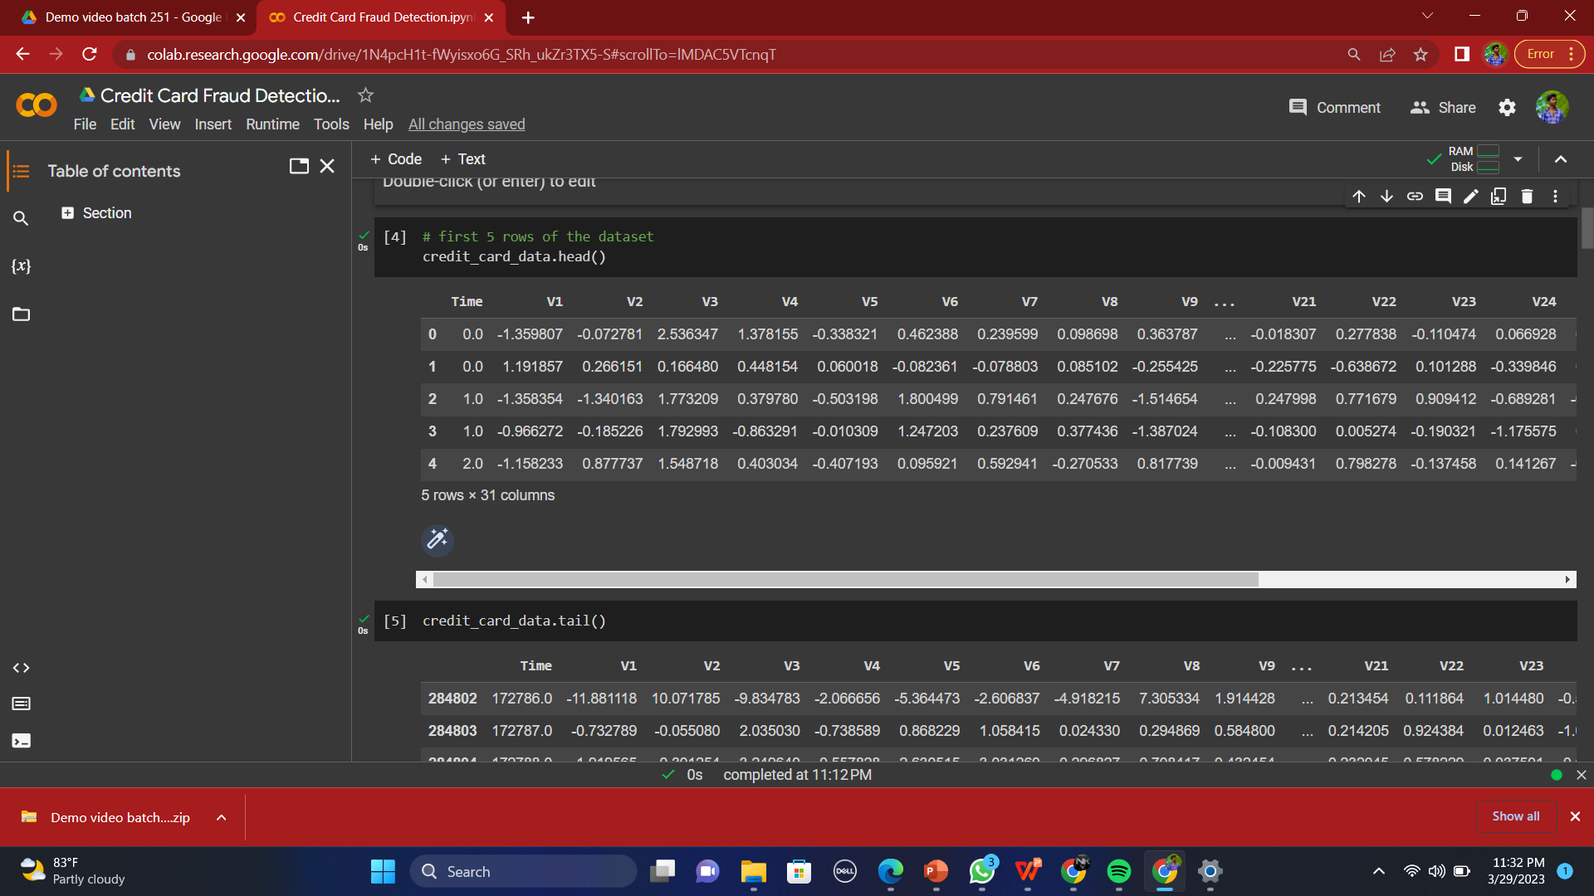
INPUT AND OUTPUT
Input

Slide 25

OUTPUT

Slide 26
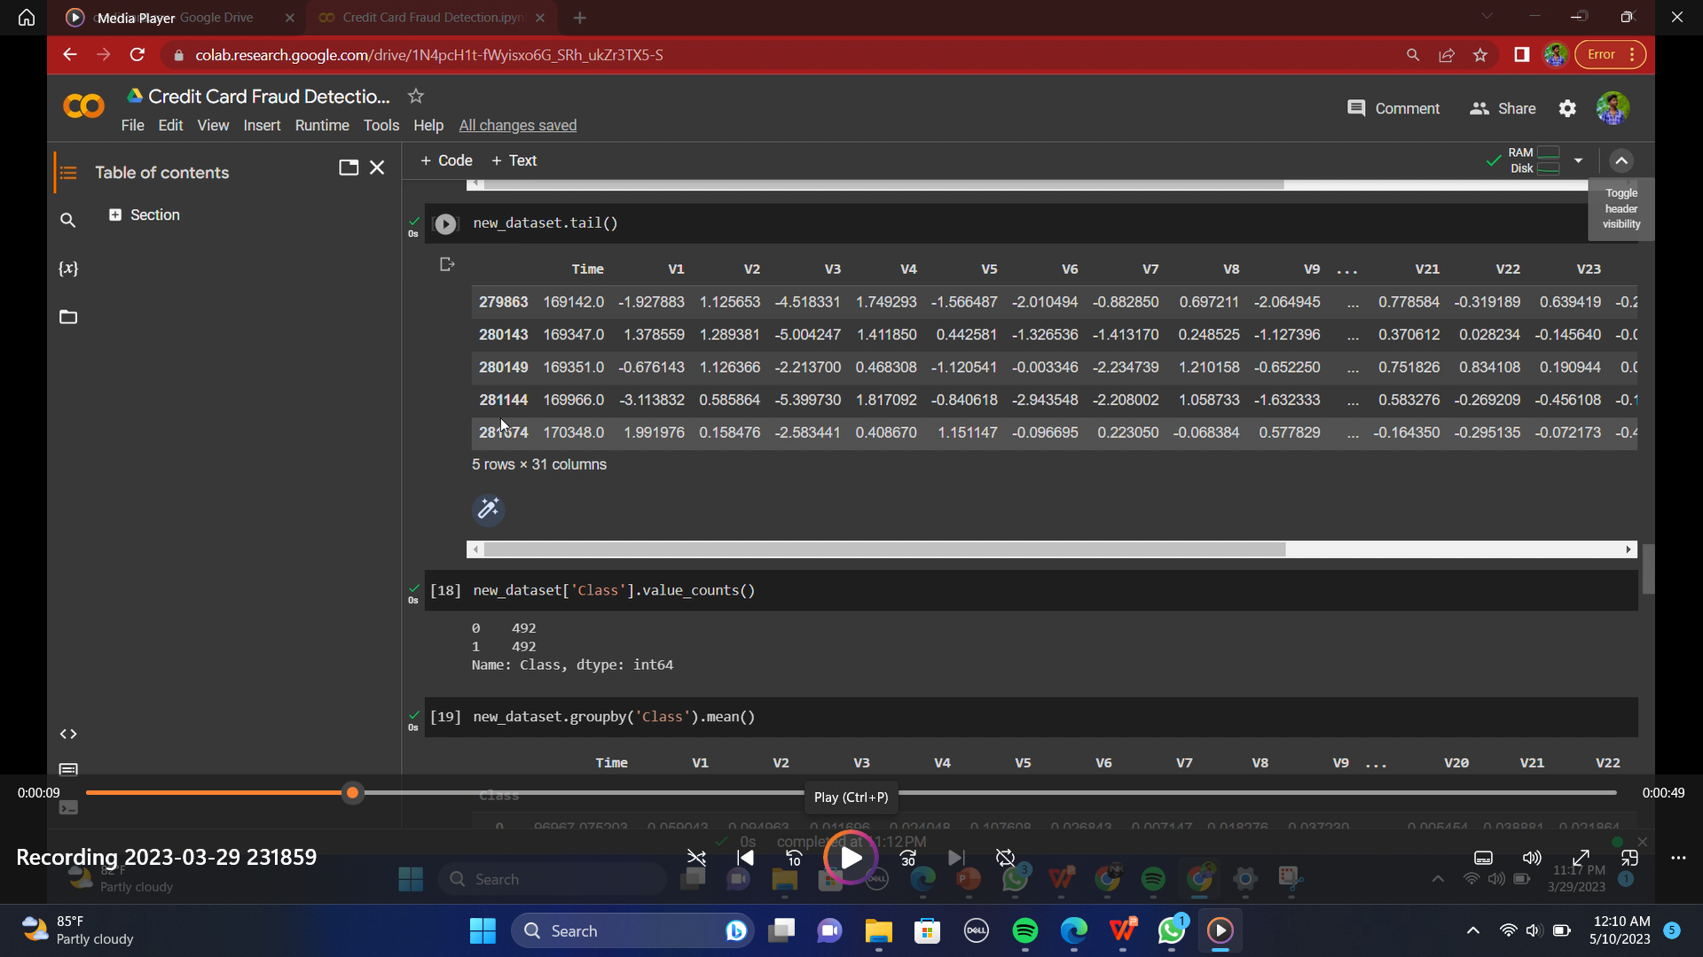
DEMO VIDEO
https://drive.google.com/file/d/1b-HZjnkNS-k1oajNmwPCfS6yAmGeQGTz/view?usp=share_link

Slide 27
CONCLUSION
In conclusion, the proposed fraud credit card detection system using machine
learning with logistic regression has shown promising results in accurately
detecting fraudulent transactions. Logistic regression has demonstrated its
effectiveness in classification tasks and has provided a reliable method for identifying
fraudulent credit card transactions. The system is designed to be user-friendly and
efficient,making it suitable for use in real-world scenarios. Furthermore, the system’s
performance can be enhanced by using a large dataset and improving the
feature selection process. Overall, the proposed system has the potential to provide
a valuable tool for detecting and preventing fraudulent credit card transactions, helping
to protect both consumers and financial institutions from financial losses.
Therefore, the proposed system should be continuously updated and monitored to
improve its accuracy and effectiveness. Overall, the proposed system is a significant
step forward in credit card fraud detection and can help financial institutions prevent
fraud and protect their customers’ assets.

Slide 28
Future Enhancements
Incorporating more data sources: In addition to transaction data, credit card fraud 40 detection systems can be enhanced by incorporating data from other sources, such as social media, online forums, and dark web marketplaces. This can help identify new types of fraud and stay ahead of emerging threats.
Using advanced machine learning techniques: As machine learning algorithms continue to evolve, credit card fraud detection systems can benefit from using more advanced techniques such as deep learning, reinforcement learning, and natural language processing. These techniques can help detect more complex patterns and anomalies that may be missed by traditional machine learning algorithms.
Real-time fraud detection: Real-time fraud detection can help prevent fraudulent transactions from being processed immediately. By analyzing transactions in real_x0002_time and using predictive analytics, fraud detection systems can identify potentially fraudulent transactions and stop them before they are completed.
Collaboration between financial institutions: Collaborative fraud detection systems can be developed that allow different financial institutions to share data and insights about fraud. This can help identify fraud patterns and trends that may not be visible within a single organization.

Slide 29
Web references/video links
https://www.kaggle.com/mlg-ulb/creditcardfraud
https://ibm.ent.box.com/v/tabformer-data/folder/130747715605
Google Colab [Online]. Available: https://colab.research.google.com/
Scikit-learn : machine learning in Python [Online]. https://scikit-learn.org/stable/
Altman ER. Synthesizing credit card transactions. 2019. arXiv preprint arXiv:1910.03033

Slide 30
REFERENCES(as per IEEE format only)
[1] A. H. Alhazmi and N. Aljehane - A Survey of Credit Card Fraud Detec- tion Use MachineLearning, 2020 Int. Conf. Computes. Inf. Technol. ICCIT 2020, pp. 10–15, 2020, doi:10.1109/ICCIT-144147971.2020.9213809.
[2] Armel and D. Zaidouni, ”Fraud Detection Using Apache Spark,” 2019 5th International Conference on Optimization and Applications (ICOA), Kenitra, Morocco, 2019, pp. 1-6. doi:10.1109/ICOA.2019.8727610
[3] A. Charleonnan, ”Credit card fraud detection using RUS and MRN al- gorithms,” 2016 Man_x0002_agement and Innovation Technology International Con- ference (MITicon), Bang-San, 2018, pp.MIT-73- MIT-76. doi: 10.1109/MITI- CON.2016.8025244 .
[4] Dejan Varmedja, Mirjana Karanovic, Srdjan Sladojevic, Marko Arsen- ovic, and Andras Anderla,Credit Card Fraud Detection - Machine Learning methods, Publish in:18th International Symposium INFOTEH-JAHORINA, 20- 22 March 2019 (IEEE).
[5] F. Ghobadi and M. Rohani, ”Cost sensitive modeling of credit card fraud using neural network strategy,” 2019 2nd International Conference of Signal Processing and Intelligent Systems (ICSPIS), Tehran, 2016, pp. 1-5. doi: 10.1109/IC- 4 SPIS.2016.7869880
[6] Z. Kazemi and H. Zarrabi, ”Using deep networks for fraud detection in the credit card trans_x0002_actions,” 2020 IEEE 4th International Conference on Knowledge- Based Engineering and Innovation (KBEI), Tehran, 2017, pp. 0630-0633. doi: 10.1109/KBEI.2017.8324876
[7] Kuldeep Randhawa, Chu Kiong Loo, Manjeevan Seera, Chee Peng Lim, Ashoke K. Nandi,Credit Card Fraud Detection Using AdaBoost and Majority Voting, Published in: IEEE Access on 15 February 2021, vol. no.6, pp. 14277 – 14283.
[8] A. Mishra and C. Ghorpade, ”Credit Card Fraud Detection on the Skewed Data Using Various Classification and Ensemble Techniques,” 2020 IEEE International Students’ Conference on Electrical, Electronics and Computer Science (SCEECS), Bhopal, 2020, pp. 1-5. doi:10.1109/SCEECS.2018.8546939

Slide 31
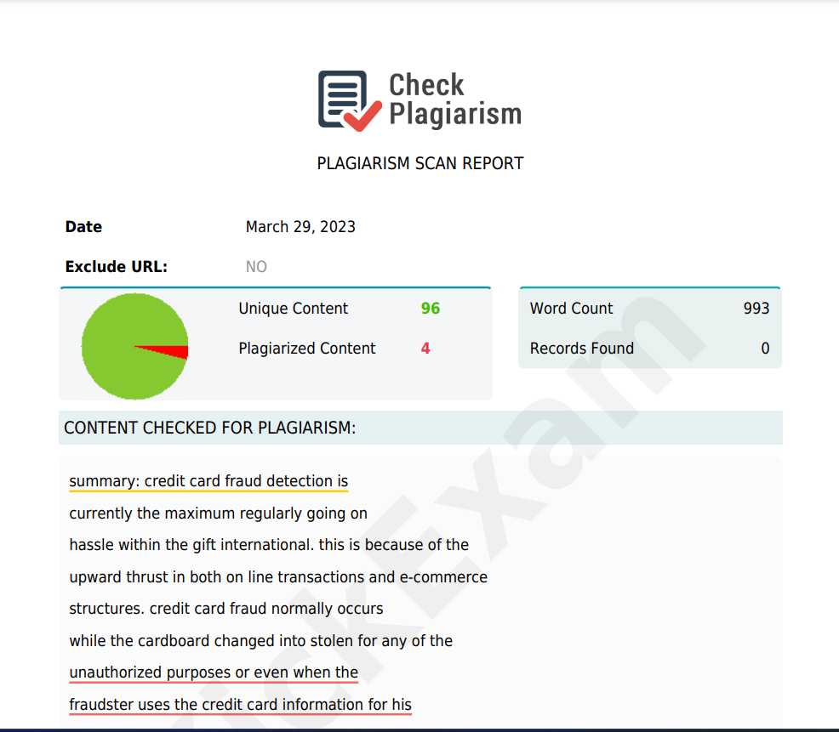
Plagiarism Report of PPT

Slide 32
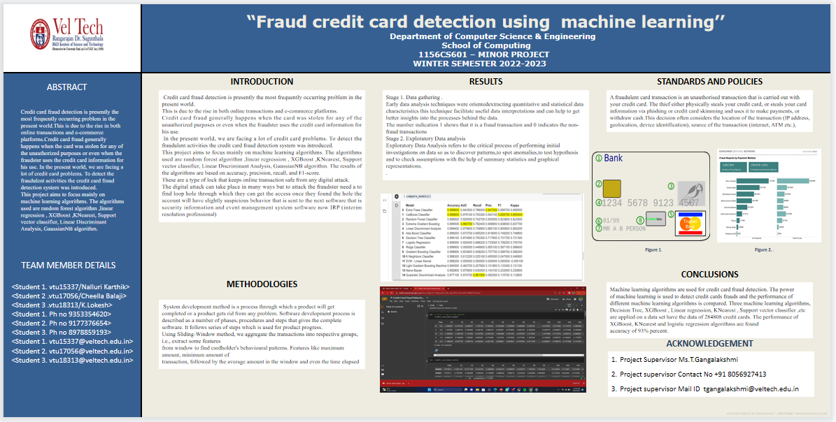
Poster Presentation

Slide 33
THANK YOU

